Slide 1
GALE BUSINESS: ENTREPRENEURSHIP
Notes:
Use this slide to introduce yourself and the presentation.
Notes throughout this presentation provide instruction around areas to customize for your specific audience, as well as speaker notes to make the process of presenting easier. Feel free to hide slides and select what content to feature if you are given shorter speaking times, or if you’re able to take attendees live into Gale Business: Entrepreneurship.

Slide 2
GALE BUSINESS: ENTREPRENEURSHIP
Discover Premium Resources
Trusted news and magazines, top periodicals, multimedia content, and business plans
Support Small Business Needs
Frequently searched topics, business types, and “how to” questions
Engage all Users
Google/Microsoft integration, unlimited print/download/email, translation, accessibility tools, and more
Notes:
Gale Business: Entrepreneurship supports patrons as they begin their journey to start, finance, or manage a small business. Includes sample business plans, how to guides, articles, and more.
Users will find a vast array of resources focused on key topics like business structuring, working with investors, networking, and legal matters. Topic organization allows for access to grouped themes (like Managing a Business) for maximum content discovery.

Slide 3
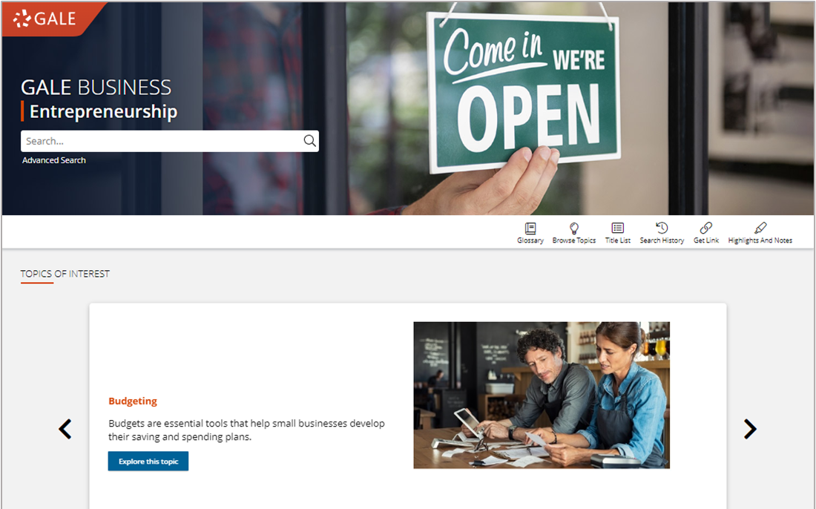
SIMPLE ACCESS
Anytime
Anywhere
Any Device
Without Ads or Paywalls
Notes:
All of the content in Gale Business: Entrepreneurship can be accessed by you and your patrons 24/7 on any device, no matter where you are. Additionally, Gale Business: Entrepreneurship is an ad-free environment that provides full-text access without paywalls.

Slide 4
DISCOVER PREMIUM RESOURCES

Slide 5
SEARCH OR BROWSE
EXPLORE CONTENT
VIEW AND SHARE
Notes:
It’s easy to access all the premium resources within Gale Business: Entrepreneurship by browsing or searching for topics of interest, exploring content organized by type, and then clicking individual result titles to view and use recommended resources, business plans, journals, videos, directories, and more.

Slide 6
SEARCH
Enter simple search terms
Notes:
To perform a basic search, just enter key terms related to topics of interest in the search box on the homepage or at the top of every page throughout Gale Business: Entrepreneurship.

Slide 7
SEARCH
Enter simple search terms
Or, customize multiple fields and limiters
Notes:
You can also run a more targeted or customized search by clicking the Advanced Search option beneath or to the side of the basic search box. Advanced Search provides the option to select specific search fields (For example, publication title if you’re looking for articles in a specific journal) and combine these fields/terms in various ways (for instance using NOT if you want articles about one subject, but are NOT interested in any articles that also focus on a related subject that is not relevant to what you are researching). If you scroll down the page, you can also include search options to limit results by document type, date, and more.

Slide 8
BROWSE
Browse business topics
Or, browse business types
Notes:
In addition to searching, Gale Business: Entrepreneurship is designed to make it easy for your patrons to browse for topics of interest. Simply click the Browse Topics option in the upper right corner of the homepage and on many other pages throughout the resource to access a list of all topics for which there are curated pages. If desired, you can use the drop-down menu at the top of this page to view pages based on categories of interest.
When you click the title of one of the topics, you’ll be taken to a results list focused on your topic. Simply click the header for a content type to view all results of that format, and click the title of an individual result to view that specific piece of content.
Note that if you do not see a topic related to something of interest, that just means that you will need to run a basic or advanced search within Gale Business: Entrepreneurship to view any available results (it doesn’t mean content on that topic is unavailable).

Slide 9
BROWSE
Browse “how to” topics
Notes:
Gale Business: Entrepreneurship includes an option to view “how to” topics with results curated to common small business patrons need, like starting a business or getting funding.

Slide 10
EXPLORE AND FILTER RESULTS
EXAMINE CONTENT TYPES
Select a Content Type to focus on results within that format
Notes:
Once you run a search you’ll find options to further pinpoint results of interest. At the top of the page, you can click to view results of specific types (news, business plans, etc.) depending on what’s available for your search.

Slide 11
EXPLORE AND FILTER RESULTS
EXAMINE CONTENT TYPES
Select a Content Type to focus on results within that format
NARROW RESULTS
Limit by publication title, subjects, peer-reviewed journals, etc.
Notes:
In the Filter Your Results portion on the right-hand side of the results, you’ll find options to limit your search results further based on publication date, subjects, document types, etc. Simply click one of the filtering options, check the box next to specific filters of interest, and then click to Apply the filter.
Note that these are also great options to point out to patrons who are running very broad searches.

Slide 12
EXPLORE AND FILTER RESULTS
EXAMINE CONTENT TYPES
Select a Content Type to focus on results within that format
NARROW RESULTS
Limit by publication title, subjects, peer-reviewed journals, etc.
VIEW INDIVIDUAL SOURCES
See document information like date, publication, and word count before selecting it
Notes:
When you find an item that you’d like to view, simply click the title of the result to access the content.

Slide 13
EXPLORE CONTENT
MAGAZINES AND JOURNALS
MULTIMEDIA MATERIALS
BUSINESS PLANS
DIRECTORIES
NEWS
Notes:
Depending on the topic you search or browse, you will find a wide variety of content types.

Slide 14
EXPLORE CONTENT: BUSINESS PLANS
BUSINESS PLANS
Over 1,000 real-world business plans sourced from Business Plan Handbook
Perfect for patrons just starting out and looking for business organizational support
Notes:
Business plans contain all parts of a standard business plan including executive summary, industry analysis, business structure, and financial projections. Patrons will also find helpful graphs and charts to explore the best organization for their business.
Business plans can be filtered based on industry or subject using the Subjects filter.

Slide 15
EXPLORE CONTENT: MAGAZINES AND JOURNALS
MAGAZINES AND JOURNALS
Both general and industry specific journals and magazines provide a full picture of the current business climate
Patrons looking for information to enhance their current business practices will benefit
Notes:
Magazines and Journals within Gale Business: Entrepreneurship include industry-specific journals like Real Estate Weekly and Internet Business News, as well as more broad publications like The Economist.
A Publication Search found within our Advanced Search can allow patrons to limit to a specific journal of interest, or they can use the Publication Title filter in their search results.

Slide 16
EXPLORE CONTENT: DIRECTORIES
DIRECTORIES
Provide contacts for patrons looking for support related to a wide variety of business topics including marketing, web design, and financing
Notes:
Directories direct your patrons directly to business that can support their goals. Most directories include phone number, email, and an outline of the company’s activities.
The Search Within filter can help your patrons narrow to a specific type of company, like HR consultants.

Slide 17
EXPLORE CONTENT: DIRECTORIES
NEWS
Provide recent coverage, in-depth analysis, and both real-world and academic perspectives
New content is being added daily from key publishers including The Washington Post, Morning Edition, and Investor’s Business Daily
Notes:
Periodical feeds within Gale resources update multiple times per day, so you can be sure you’ll find recent coverage of trending topics from authoritative sources.

Slide 18
EXPLORE CONTENT: DIRECTORIES
MULTIMEDIA
Video and audio files provide an additional option to access materials
All entries are short (generally under 20 minutes) to ensure continued engagement
Notes:
Multimedia content supports researcher preference to increase accessibility.

Slide 19
ENHANCE RESEARCH

Slide 20
SHARE AND SAVE CONTENT
Get Link, Send To, Download, Print
Collect premium resources to share with colleagues, or save for later
INCREASE ACCESSIBILITY
Translate, Text Manipulation, Listen
Provide options for patrons with varied needs and preferences
SUPPORT BUSINESS DEVELOPMENT
Glossary, Topic Pages, and Highlights and Notes
Allow patrons to organize research and find key points in business topics and ideas
Notes:
These tools support patrons through all stages of research as well as business development. Patrons will be able to find and save the content they need, access it in the best possible format for them, and highlight important ideas right in their documents.

Slide 21
SHARE AND SAVE CONTENT
GET LINK
Create a persistent URL to the page you are on
Notes:
Get Link links are persistent- they won’t break over time. These links are great for you to share with patrons through social media, email lists, or business groups. Patrons can also utilize these links to save their content for later or share the content with peers/ colleagues.
When someone selects a link they will be automatically taken to that page within Gale Business: Entrepreneurship. If they decide to navigate through the resource, they will be asked to authenticate in whatever method you have established.

Slide 22
SHARE AND SAVE CONTENT
GET LINK
Create a persistent URL to the page you are on
SEND TO
Send articles to a Google or Microsoft drive, or email
Notes:
Sending materials to Google or Microsoft drive allows your patrons to keep the full text for as long as they want. The content will be sent to whatever drive is signed into on the browser. If a patron hasn’t signed into their account yet, it will prompt them. They can access these tools either in the tool bar at the top of a document page, or in the tool buttons on the right side under the document information.

Slide 23
SHARE AND SAVE CONTENT
GET LINK
Create a persistent URL to the page you are on
SEND TO
Send articles to a Google or Microsoft drive, or email
PRINT AND DOWNLOAD
Print full documents, or download directly to your computer
Notes:
Unlimited printing and downloading allow patrons to access their full text offline.
These buttons are found next to the Send To button in the tool bar and the buttons under the title.

Slide 24
INCREASE ACCESSIBILITY
TRANSLATE
Machine translate both articles and resource navigation
Notes:
Every article includes a simple translation button allowing patrons to choose they language they prefer. Utilizing Set Interface Language will change all the navigation buttons and tools within the platform to the selected language.
To translate an article or the interface select the Translate button found in the set of tools on the left of the screen under the document information.

Slide 25
INCREASE ACCESSIBILITY
TRANSLATE
Machine translate both articles and resource navigation
TEXT MANIPULATION
Edit how article text is viewed by changing the font size, color, style, and spacing
Notes:
Utilizing the text manipulation tools provides for the most customized experience. Patrons can choose their preferences and they will be retained through the duration of their session.
These options are found in the next to the Translate button under the document information.

Slide 26
INCREASE ACCESSIBILITY
TRANSLATE
Machine translate both articles and resource navigation
TEXT MANIPULATION
Edit how article text is viewed by changing the font size, color, style, and spacing
LISTEN
Have entire articles read to you, including title, and any image captions
Notes:
The Listen tool includes options to have words and sentences highlights as they are read, as well as the option to increase or decrease the reading speed. Patrons can download the MP3 to listen to the article on the go.
Access this feature next to the Text Manipulation tools under the document information.
Bonus: The Listen tool will read the article in whatever language it’s translated to. So, if an article has been translated to Spanish by a patron and they then select Listen, they will listen to the text in Spanish.

Slide 27
SUPPORT BUSINESS DEVELOPMENT
GLOSSARY
Search or browse for unfamiliar terms
Notes:
To utilize the Glossary navigate to the tool bar at the top of the homepage or a search results page. Once launched patrons can either browse or search for business terms they are unfamiliar with.

Slide 28
SUPPORT BUSINESS DEVELOPMENT
GLOSSARY
Search or browse for unfamiliar terms
TOPIC PAGES
Organized pages that provide a topic overview and list all related results
Notes:
Topic Pages can be found in the bottom sections of the homepage. These pages are helpful for patrons who prefer point and click browsing over searching.

Slide 29
SUPPORT BUSINESS DEVELOPMENT
GLOSSARY
Search or browse for unfamiliar terms
TOPIC PAGES
Organized pages that provide a topic overview and list all related results
HIGHLIGHTS AND NOTES
All documents can be highlighted and annotated to support a deeper understanding of topics
Notes:
All text results include the option to add highlights and notes. To get started, select text within the document as you normally would to copy or paste text (click and drag on your computer, or tap the first and last word on mobile devices). You’ll then see a pop-out menu that provides color options and the ability to add notes. Choose the desired color for the highlight and add your thoughts to the notes field.
Be sure to take the highlighted item with you before you close the resource by downloading, printing, or sending the item to Google Drive or Microsoft OneDrive. This will provide a copy of the result including any highlights and notes you made within the document.
Note that you can also access the Highlights and Notes menu option in the upper right-hand corner of the resource to access all the highlights and notes you’ve made within a given session. This allows you to easily jump to articles and edit highlights and notes, or to download, print, or send a full list of all your highlights and notes to Google Drive or Microsoft OneDrive. Again, if you plan to use this tool, be sure to download, print, or Send to… before exiting the resource.

Slide 30
?
…
Notes:
Use this slide as a visual prompt for final questions and/or discussions

